Slide 1

Lead Scoring Case Study

Slide 2
Problem Statement and Objective
Problem Statement:
An education company named X Education sells online courses to industry professionals.
X Education company gets a lot of leads, but its lead conversion rate is only 30%. The company requires us to build a model wherein we need to assign a lead score to each of the leads such that the customers with a higher lead score have a higher conversion chance and the customers with a lower lead score have a lower conversion chance. The CEO has given a ballpark of the target lead conversion rate to be around 80%.
Objective:
The company wants to know:
The leads that are most likely to convert into paying customers
To build a model wherein you need to assign a lead score to each of the leads such that the customers with a higher lead score have a higher conversion chance and the customers with a lower lead score have a lower conversion chance

Slide 3
Approach followed
Understanding the domain/ variables
Importing the data and checking the structure of the data
Data Cleaning
EDA
Data Preparation
Model Building
Model Evaluation
Making Predictions on Test Dataset
Recommendations

Slide 4
Data Cleaning
Treating ‘Select’ values: These are basically the columns in which customers have not selected any value from the list and hence we have replaced them with Nan value.
Handling the missing/null values: All the columns that had more than 40 % missing values were dropped. All the columns which had single value “NO” and had majorly one value ex: ‘No’ were dropped as it doesn’t add any value to our data analysis.
Duplicates Check: There were no duplicates in the dataset.
Created a new category “Unknown” for the category columns that are important but has high percentage of missing values.
Numerical columns with missing values were replaced with median() after checking the skew
Columns that did not add any value for data analysis like “Prospect ID” ,”Lead Number” and “Last Notable Activity” were dropped.
Outlier treatment was done on the numerical columns which had outliers and value standardization was carried out.

Slide 5
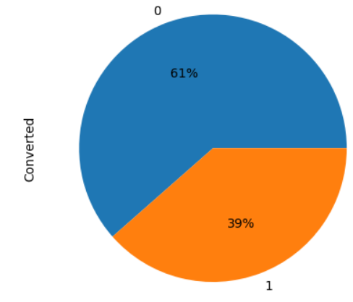
EDA: Data Imbalance
39% of people are converted to leads
61% of people did not convert to leads

Slide 6
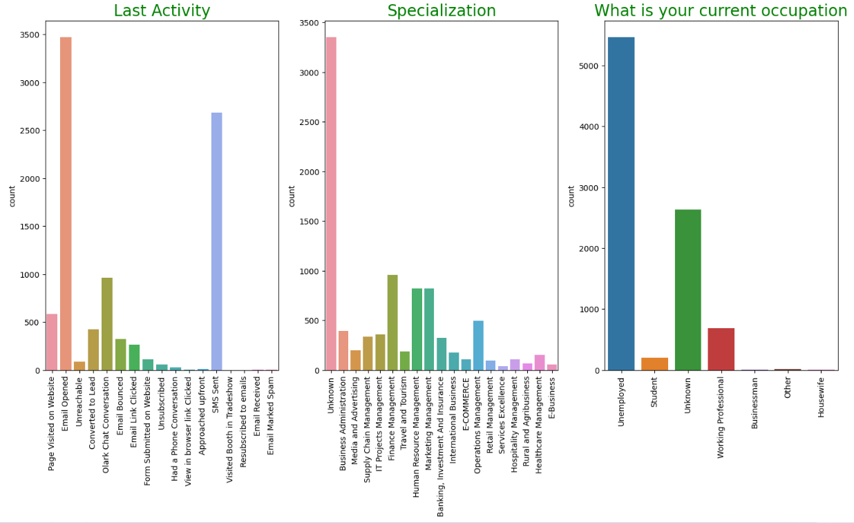
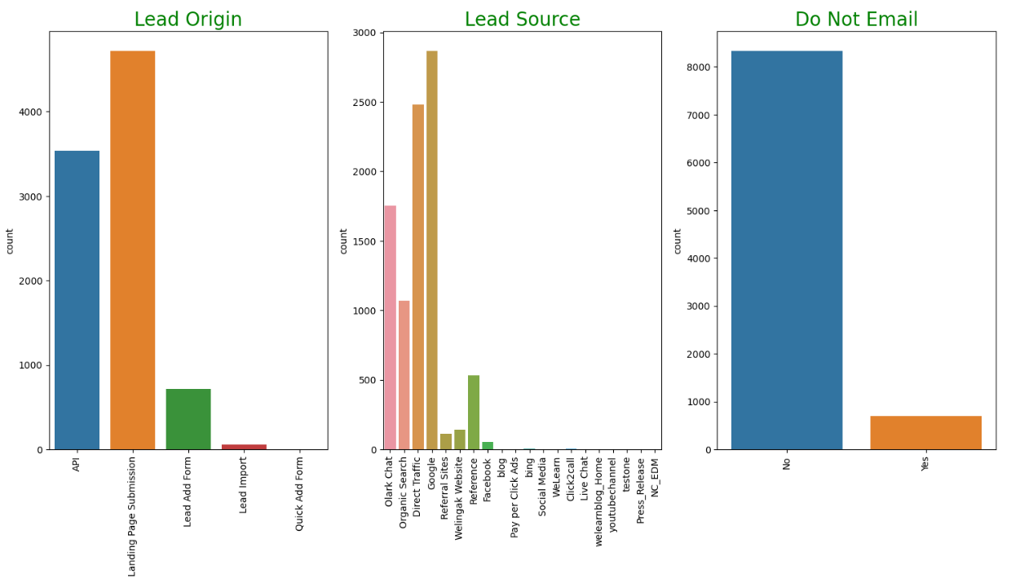
EDA: Univariate Analysis
Lead Origin : Highest number of customers are from Landing Page submission followed by API
Lead Source: Maximum number of customers are from Google followed by direct traffic
Do Not Email : Most number of customers have opted that they do not want to be emailed about the course
What is your current occupation: Most of the customers are Unemployed
Last Activity : Last activity performed by most of the customers are SMS sent and Email Opened activities

Slide 7
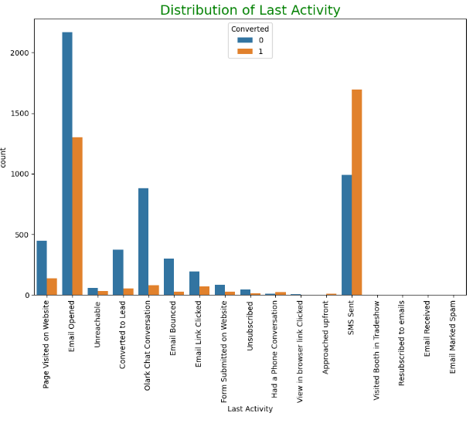
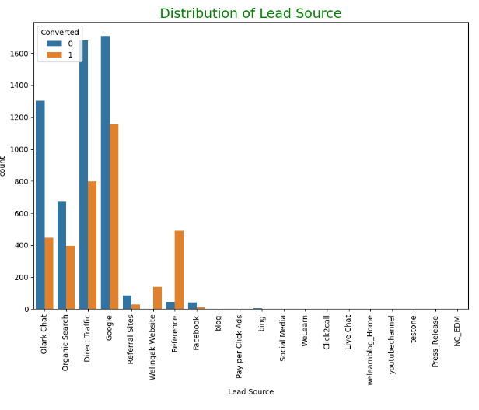
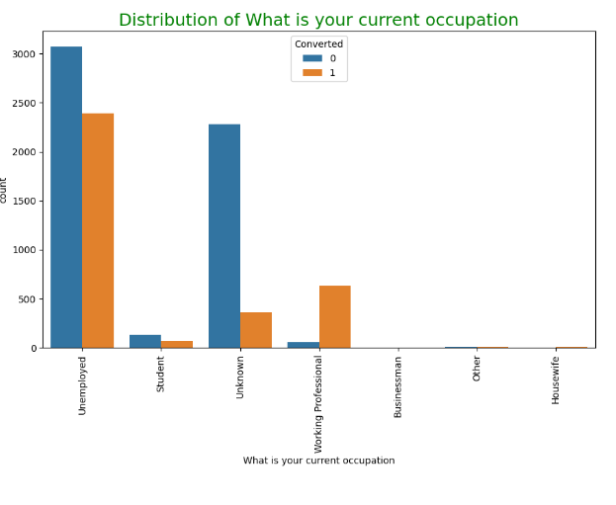
EDA: Bivariate Analysis
Lead Source - Google and Direct Traffic have generated many leads but maximum % of lead conversion is from Reference and Welingak Website
Lead Activity- SMS sent has the high percentage of Lead Conversion Rate
Current Occupation- Many leads are from Unemployed, but Working Professionals contribute to highest % of lead conversion

Slide 8
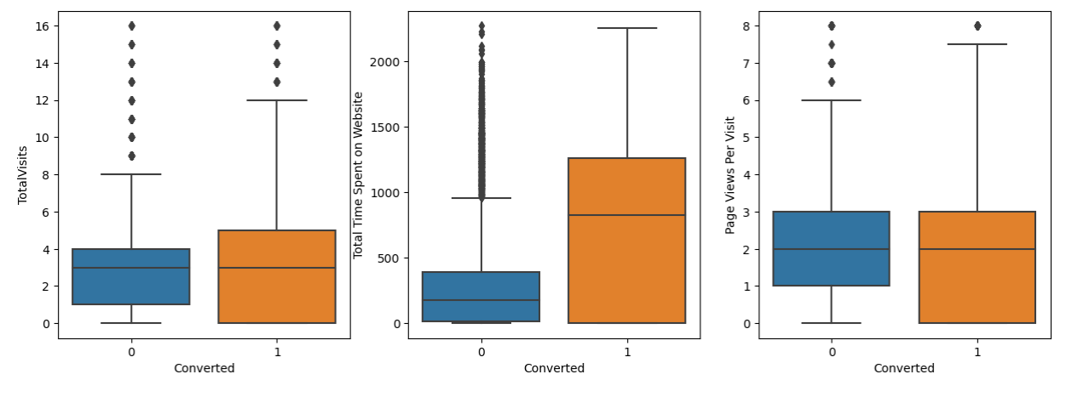
EDA: Bivariate Analysis
Leads who spend more time on Website have high conversion rate.

Slide 9
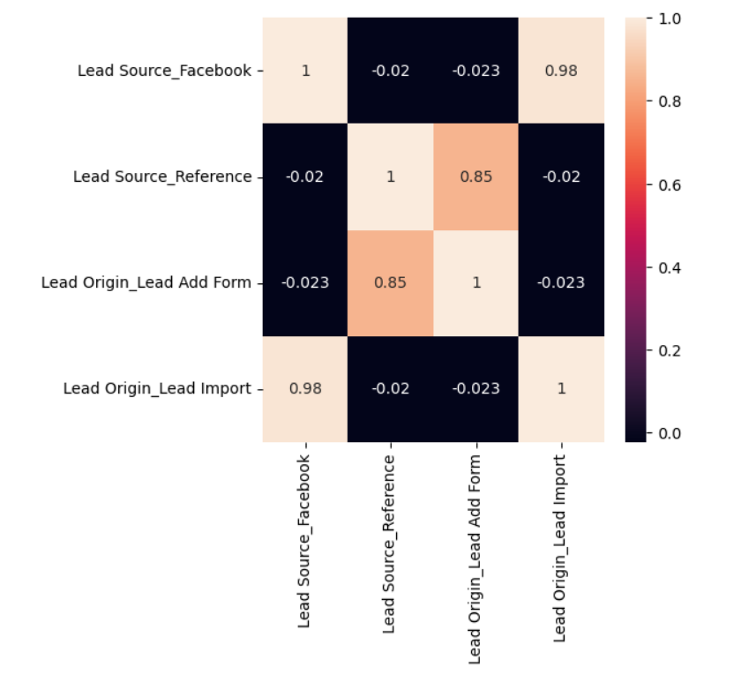
Data Preparation
Binary variables (Yes/No) were converted to 1/0
Created Dummy variables for categorical columns.
Splitting dataset into Train and Test sets (70:30 ratio)
Feature scaling using StandardScaler.
Dropping the columns that were highly correlated. “Lead Origin _Lead Add Form” and “Lead Origin_Lead Import” were dropped.

Slide 10
Model Building
Feature selection using RFE.
Manual feature reduction using P-values by dropping features with P-values>0.05 .
VIF values were checked for multicollinearity. All the features had VIF <5
Model 2 was selected as the final model with 14 variables.

Slide 11
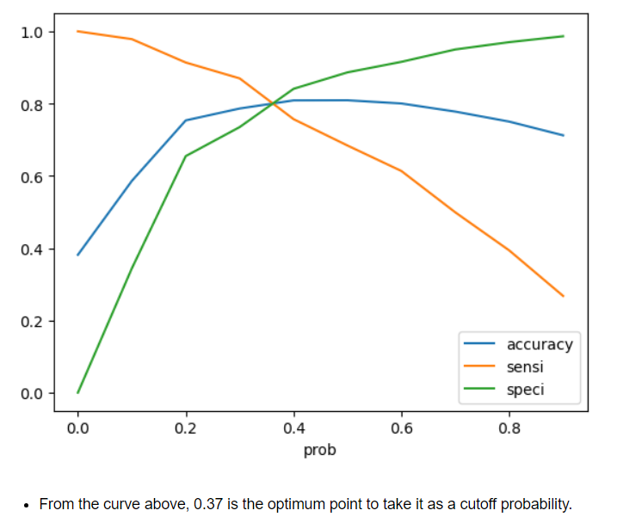
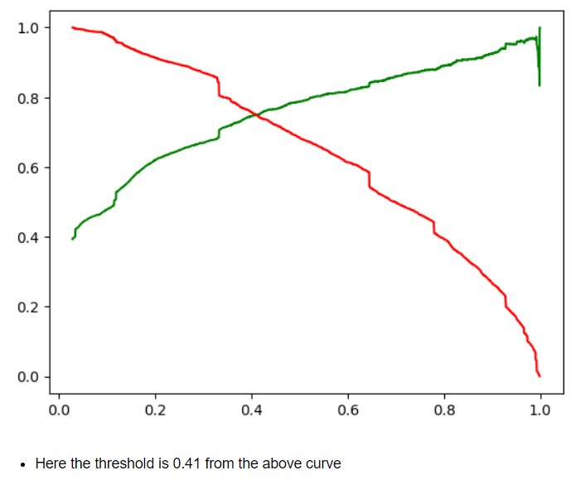
Model Evaluation
Confusion Matrix, Accuracy, Sensitivity and Specificity were checked with the default cutoff Threshold value of 0.5. Then, ROC Curve was plotted.
0.37 was then chosen as the optimal cut off probability where we get balanced sensitivity and specificity. This cutoff gave Accuracy of 80%, Sensitivity as 78% and Specificity value of 82%.
Precision and Recall matrix was checked with Threshold as 0.41. This gave precision score and recall score of 75%.
Sensitivity-Specificity view was selected for final prediction as this gave better results.
Lead Score feature was added to the training data set- A higher lead score means the lead is hot and it is most likely to be converted

Slide 12
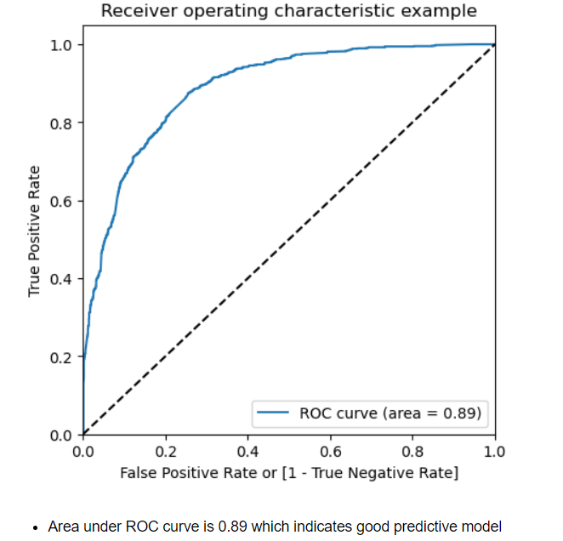
Making predictions on the test set
Scaling the test data set and making predictions on the test data set.
Drawing ROC curve on the test dataset
Evaluation metrics was calculated on test dataset. It gave Accuracy of 80%, Sensitivity as 80% and Specificity value of 81%. The model performed well on Test data as well.
Lead Score feature was added to the test data set.
Top 3 top features from the model are:
Lead Source_Welingak Website
What is your current occupation_Working Professional
Lead Source_Reference

Slide 13
Conclusion
Train set:
Accuracy - 80.45%
Sensitivity- 77.8%
Specificity- 82.04%
Test set:
Accuracy- 80.39 %
Sensitivity- 79.6 %
Specificity- 80.88 %
Model is performing well on both Training and Test set:
The model has achieved an accuracy of 80% which is in line with the objective of the X education CEO
Three top features contributing to predicting the hot leads are:
Lead Source_Welingak Website
What is your current occupation_Working Professional
Lead Source_Reference
_

Slide 14
Recommendations:
Focus more on the below features :
- Lead Source_Welingak Website
- What is your current occupation_Working Professional
- Lead Source_Reference
- Last Activity_Had a Phone Conversation
- Last Activity_SMS Sent
- Total Time Spent on Website
Welingak Website has very high lead conversion rate. So, more budget can be spent on Welingak Website like spending more budget in terms of advertising etc
Working Professionals can be targeted more as they have very high conversion rate
The leads who have sent SMS or who had a Phone conversation are more likely to convert. So, sales team should prioritize contacting them .
More focus should be on the customers who have come through Reference as it has high probability of lead conversion. To encourage more references, company can think of providing referral bonus or some discounts to the existing customers if their references gets converted
Targeting customers who are spending more time on the website
_

